Slide 1


Slide 2


Numerical Methods
National University of Science and Technology, Islamabad

Slide 3
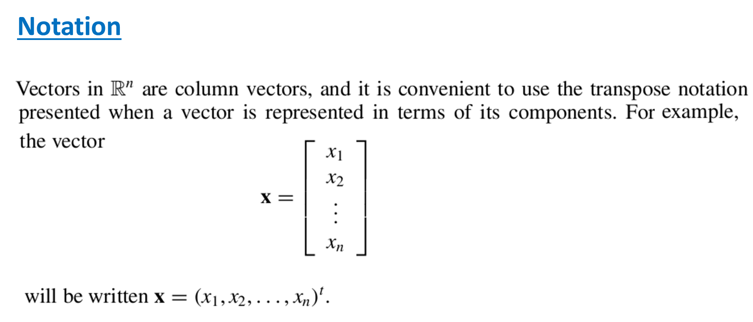
Numerical Methods
National University of Science and Technology, Islamabad

Slide 4
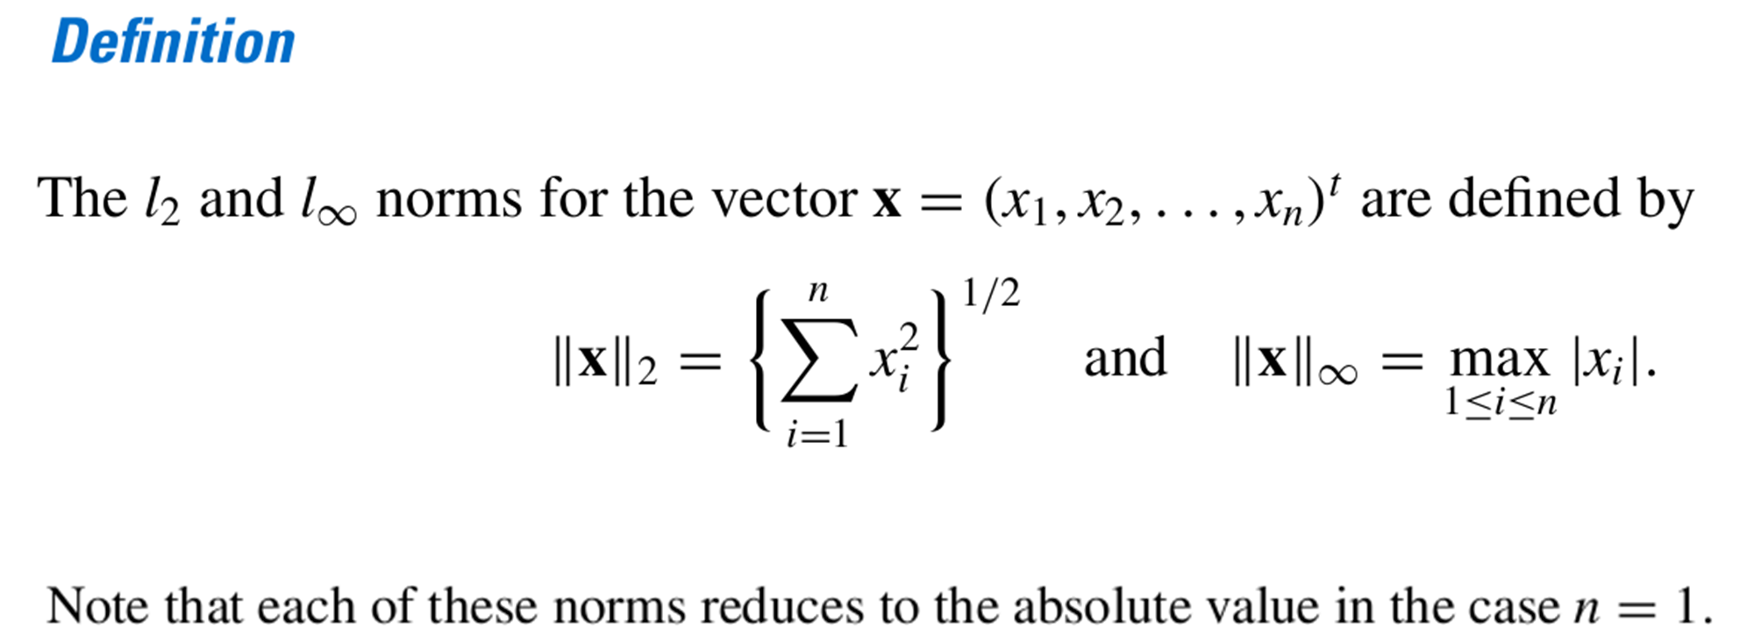
Numerical Methods
National University of Science and Technology, Islamabad

Slide 5




Numerical Methods
Problem
Solution
National University of Science and Technology, Islamabad

Slide 6
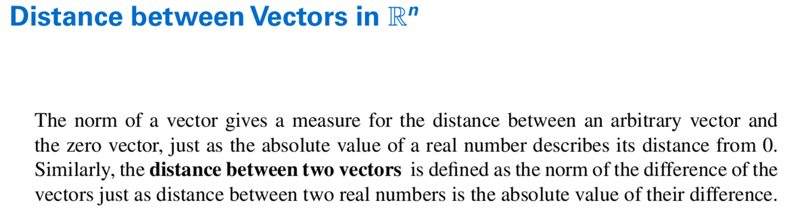
Numerical Methods
National University of Science and Technology, Islamabad

Slide 7
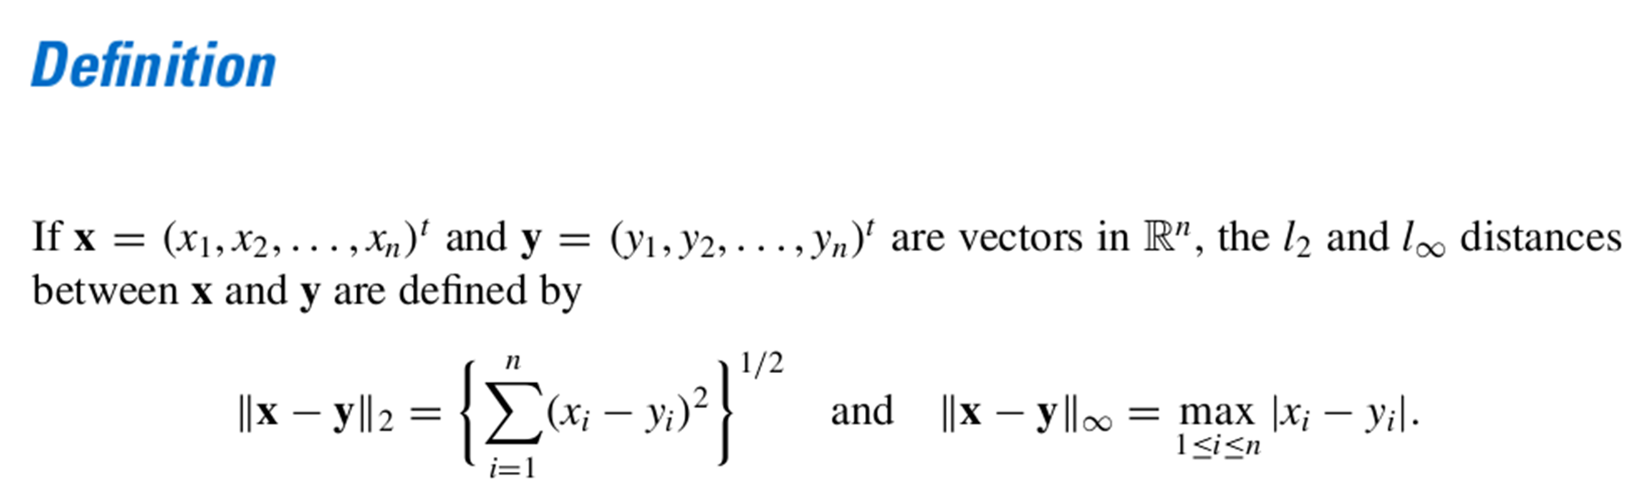
Numerical Methods
National University of Science and Technology, Islamabad

Slide 8

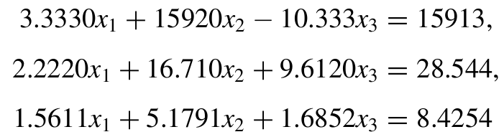
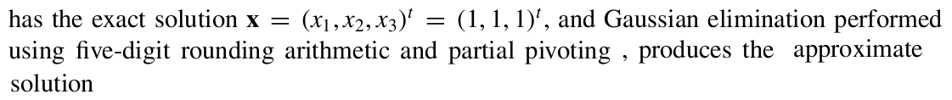

Numerical Methods
Problem
National University of Science and Technology, Islamabad

Slide 9
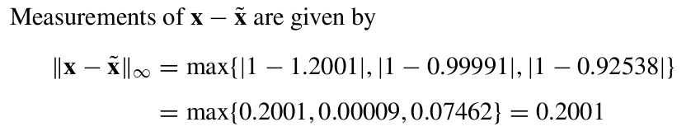
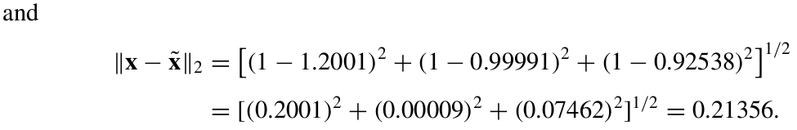
Numerical Methods
Solution
National University of Science and Technology, Islamabad

Slide 10
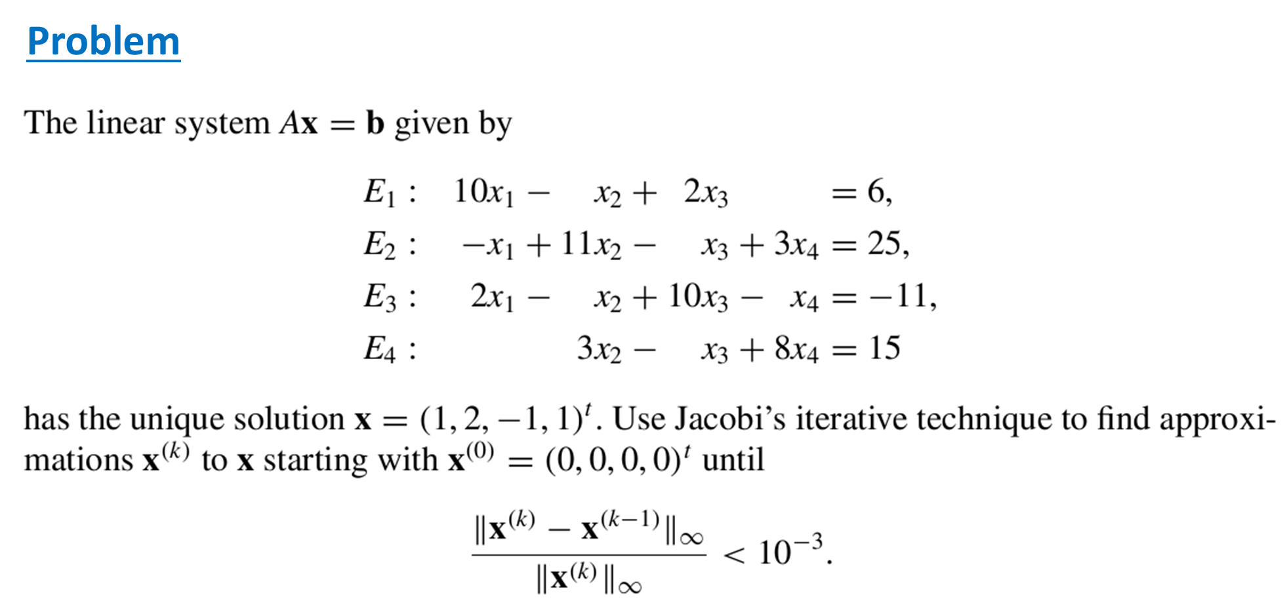
Numerical Methods
National University of Science and Technology, Islamabad

Slide 11

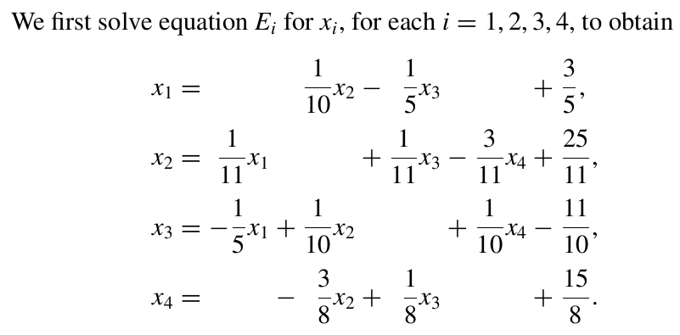
Numerical Methods
National University of Science and Technology, Islamabad

Slide 12
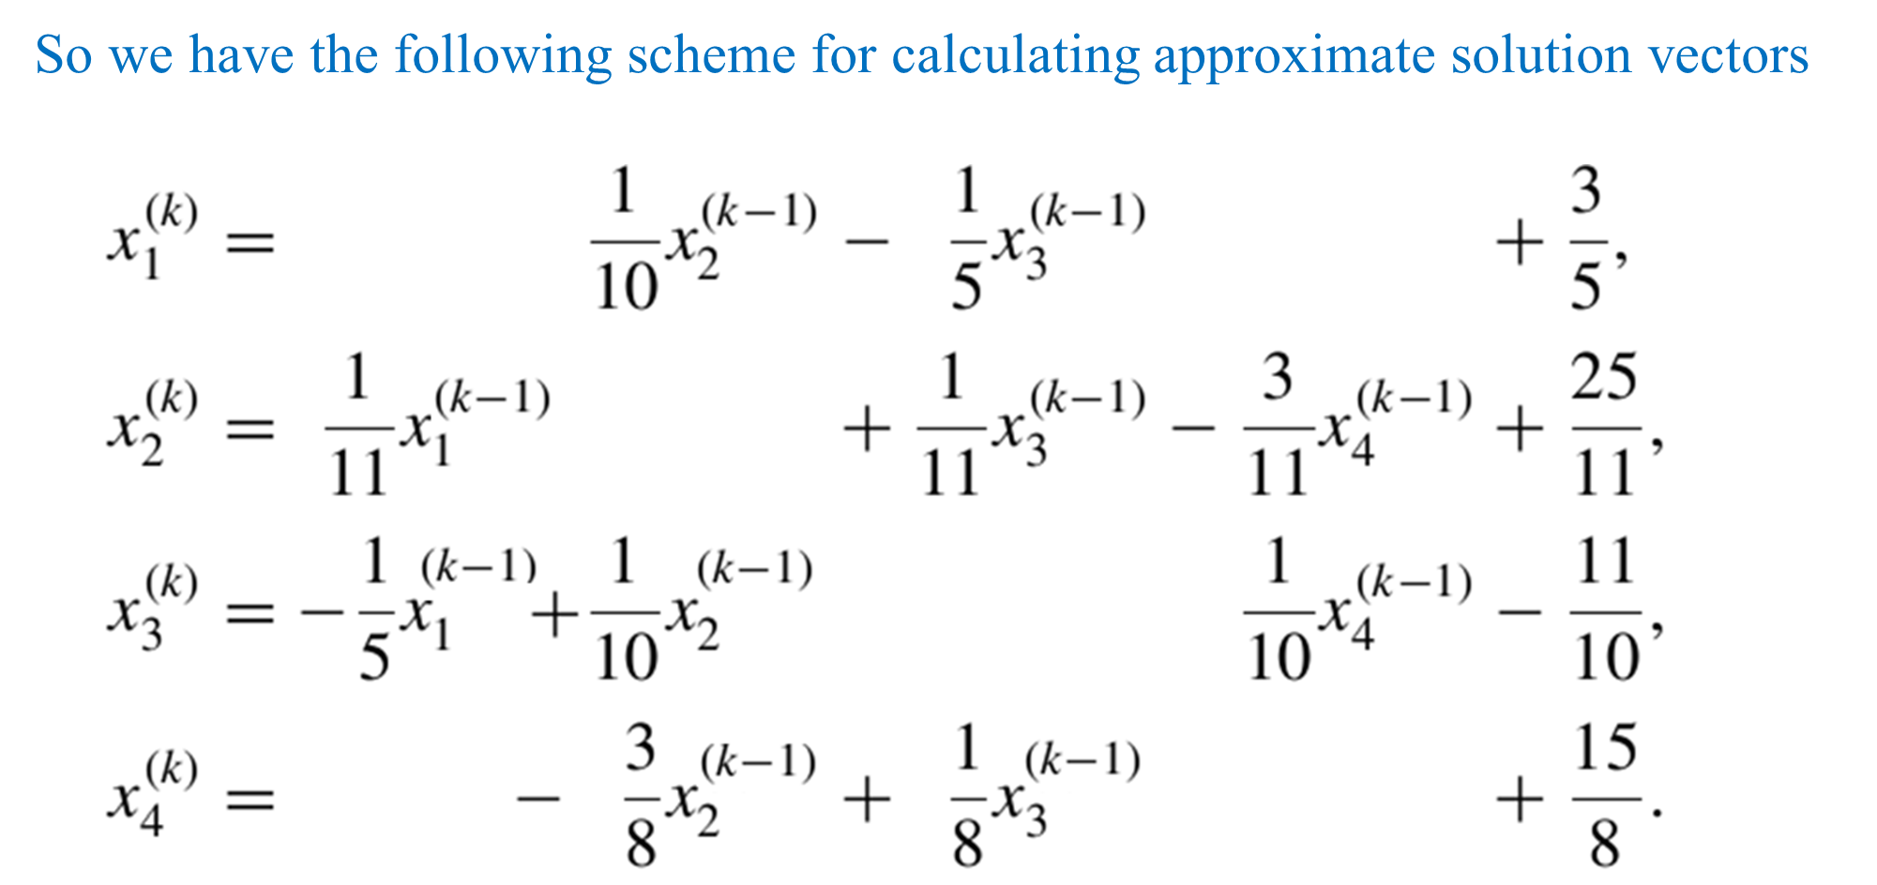
Numerical Methods
National University of Science and Technology, Islamabad

Slide 13
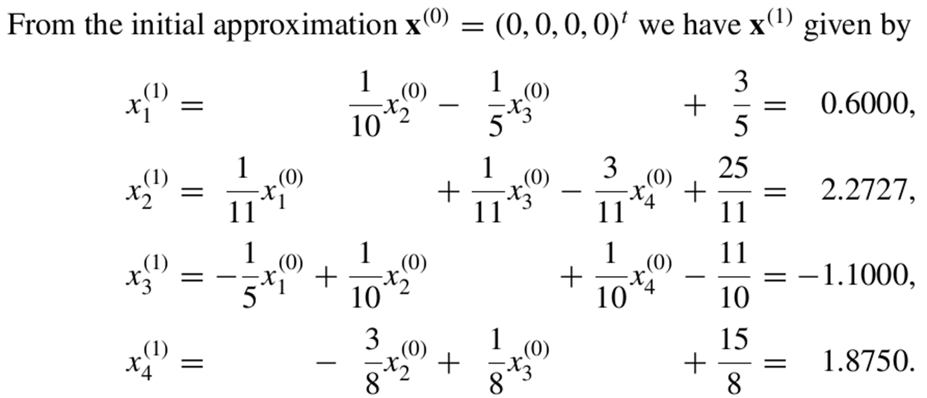
Numerical Methods
National University of Science and Technology, Islamabad

Slide 14
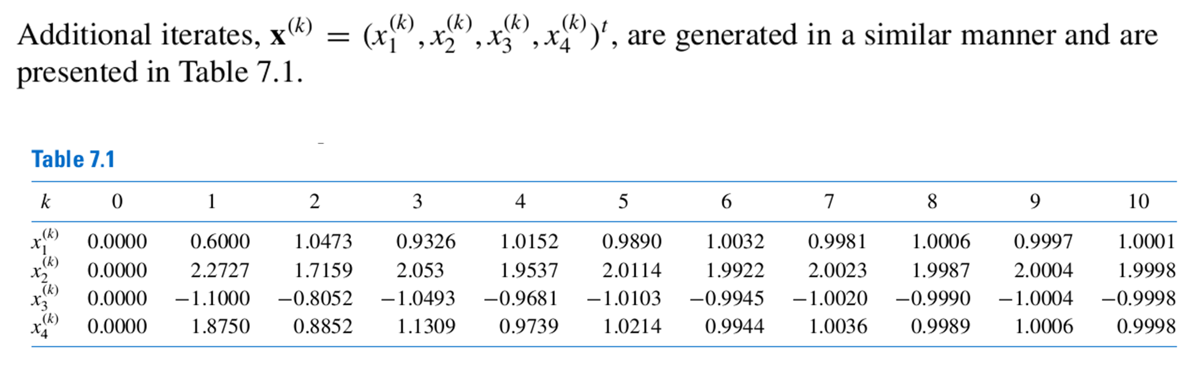
Numerical Methods
National University of Science and Technology, Islamabad

Slide 15
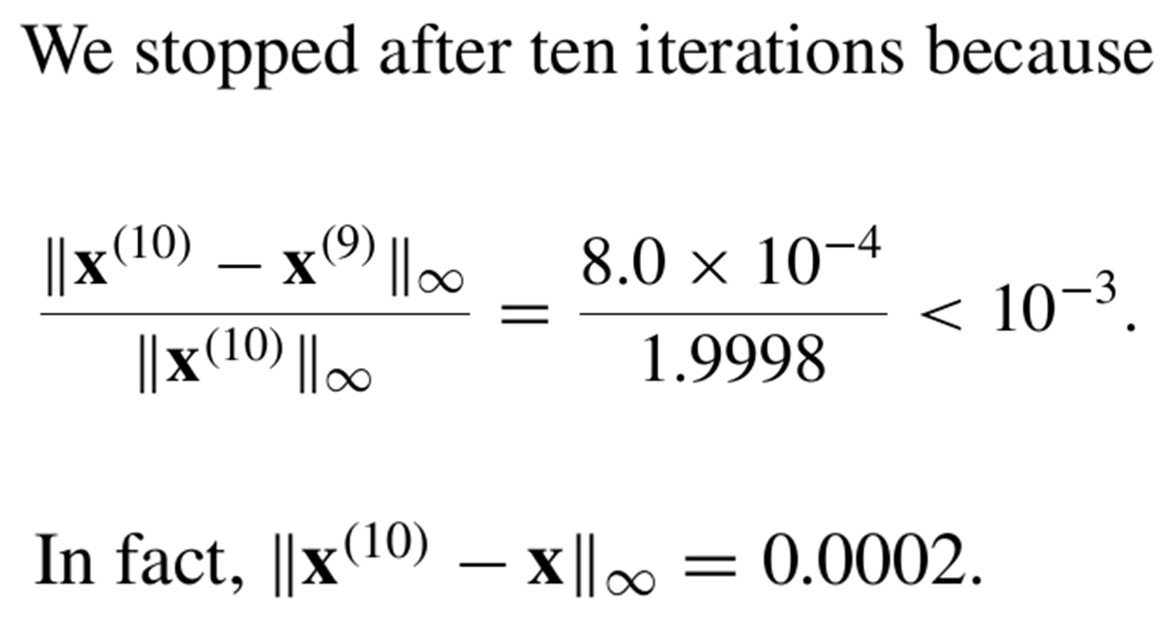
Numerical Methods
National University of Science and Technology, Islamabad

Slide 16
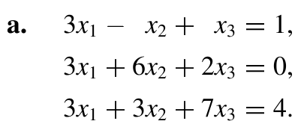

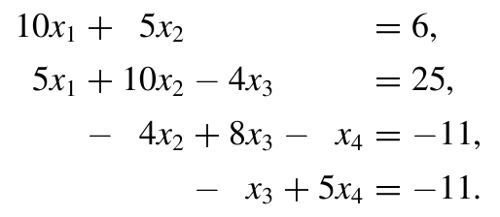
Numerical Methods
Problem 1
National University of Science and Technology, Islamabad

Slide 17
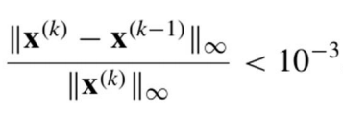
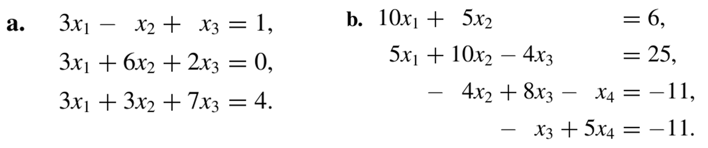
Numerical Methods
Problem 2
In the following problems find the approximate
Solutions by Jacobi’s method until
is satisfied.
National University of Science and Technology, Islamabad

